Slide 1
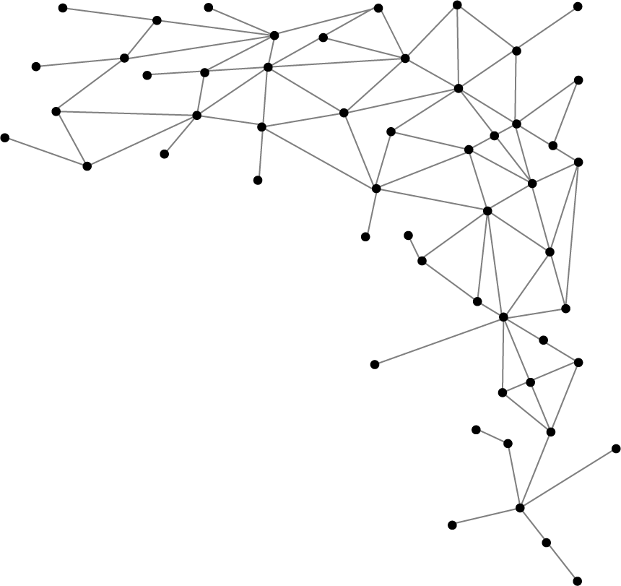




Machine Learning
I am Saif Hassan
Lecturer (CS@SIBAU)
@saifhassandr
@saifhassandr

Slide 2
Agenda
Data/Sources of Data
Overview of Machine Learning
Applications
From Input to Predictions

Slide 3




Data
Images
Text
Music
Video

Slide 4





Data

Slide 5
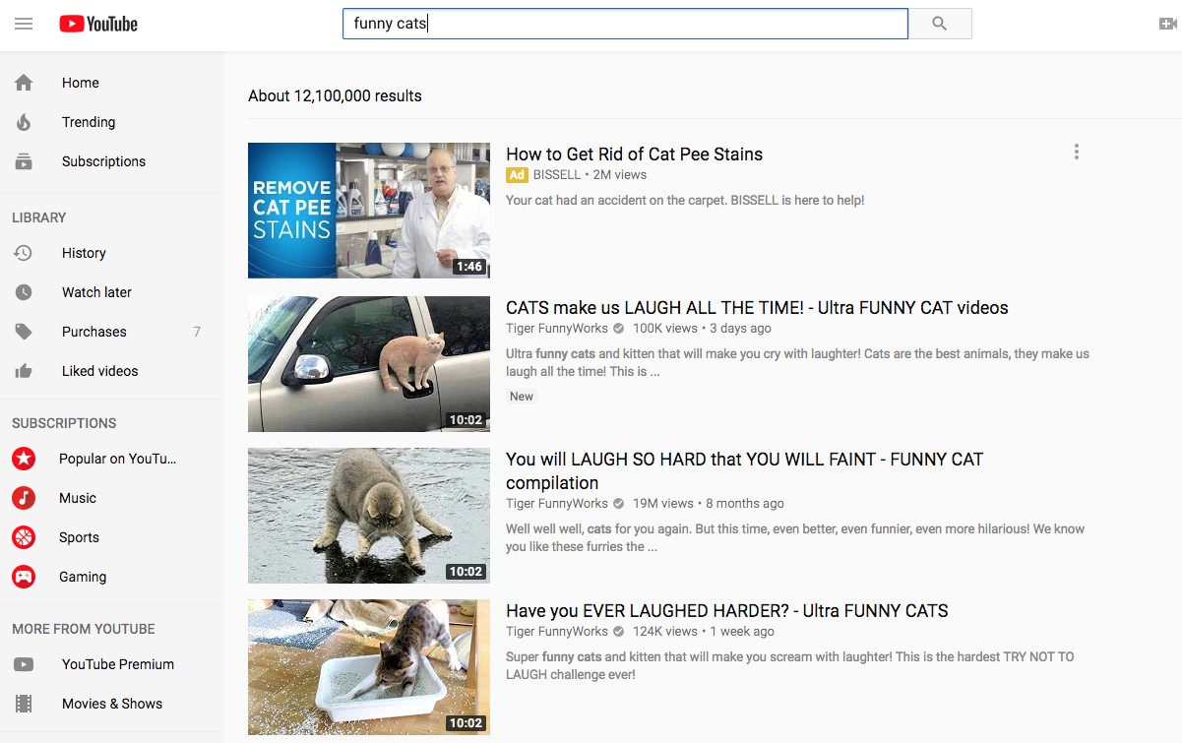
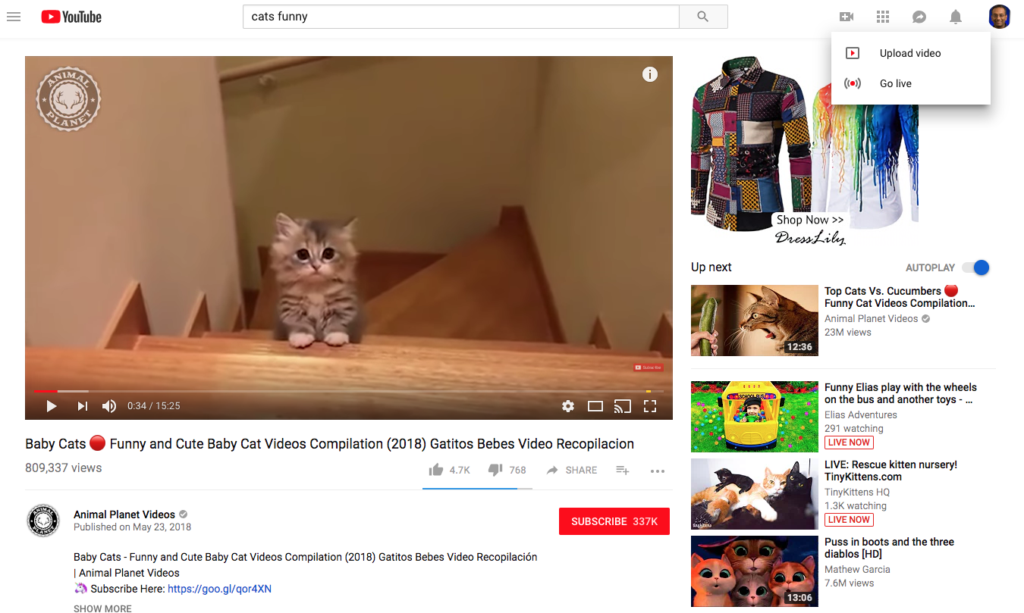

Example: Youtube DB
Notes:
Let’s start with youtube. A popular consumer app that a billion+ people use each day. It’s a massive database with petabytes of videos, descriptions and comments.
Let’s examine the consumer experience.
First, you run a query for “funny cats”. You get back list of videos and some description from the DB.
Let’s look at the blue box -- these are example queries . List of videos, # results, # video views
Let’s look at the red box. These are writes to the DB. Video uploads, comments you add, plus a counter for # likes, dislikes/
Finally, look at the green box. These are predictions on what you videos and ads you may like

Slide 6
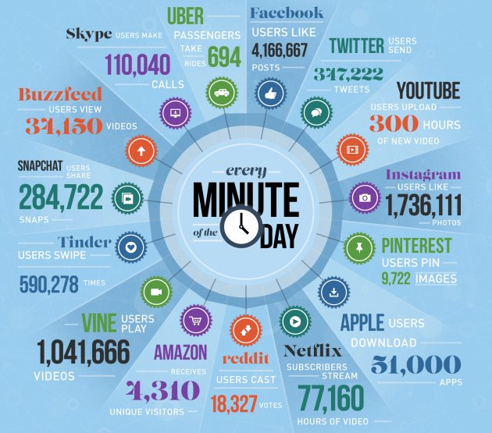
Every minute on the Internet
[Source: domo.com]
Notes:
Youtube is just one of many examples on the web. Each minute, each of these products has a data system powering user activity from videos -> music -> dating -> photos [Source: domo.com]

Slide 7
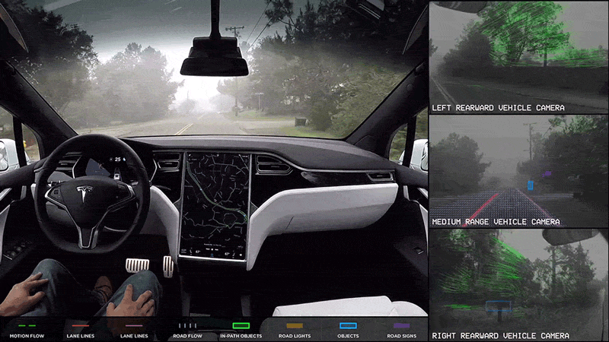
Example
Self Driving Cars
Notes:
It’s not just the web. Data is now collected from the physical world as well. For ex, look at the data processed in self-driving cars.

Slide 8
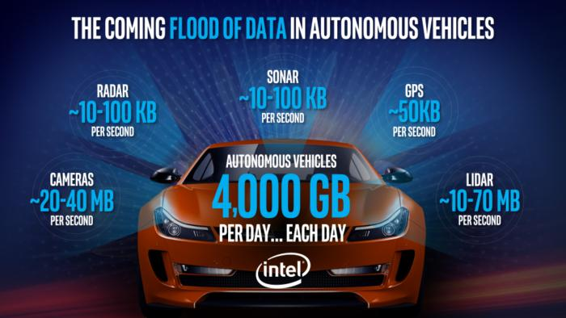
Notes:
Tons of data collected every minute-day, processed in a data system. That’s 10-20 iphones worth of storage per car/day.

Slide 9
Machine learning will automate jobs that most people thought could only be done by people.
- Dave Waters

Slide 10

What is Machine Learning?

Slide 11
Definition - ML
Systems that automatically learn programs from data.
[Domingos 2012]

Slide 12
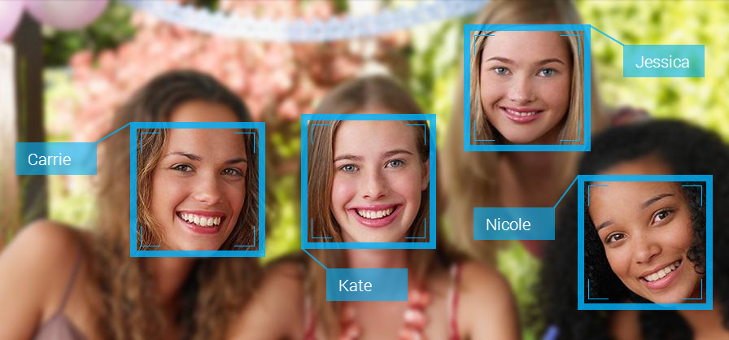
Applications - ML
Auto-Tagging people

Slide 13
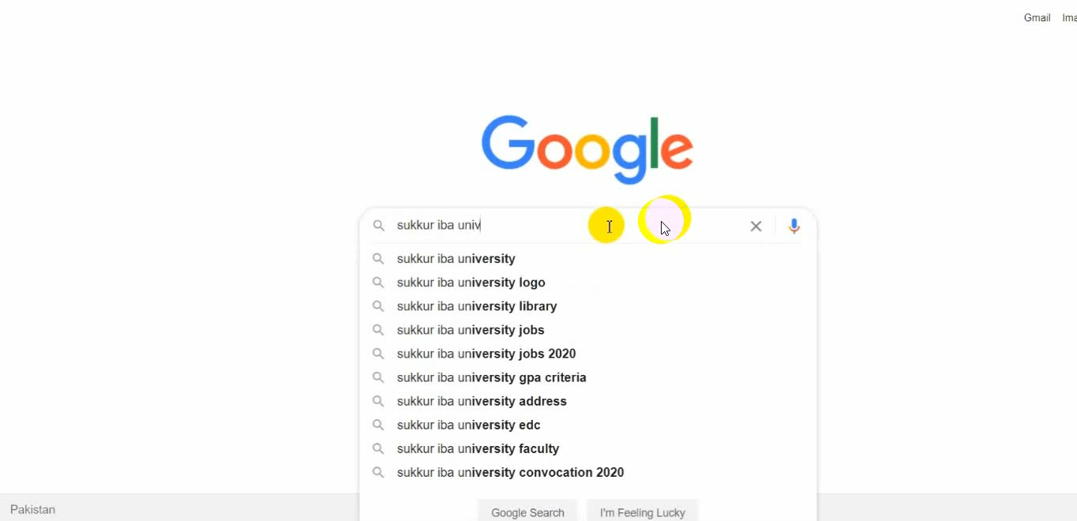
Applications - ML
Google Search Engine

Slide 14
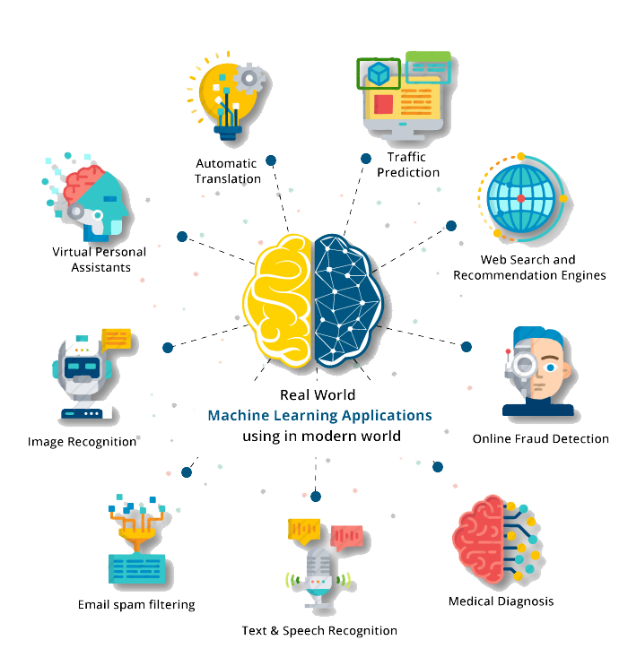
Applications

Slide 15
Machine Learning is using data to answer questions

Slide 16
using data
Training
Predictions
answer questions

Slide 17




Input Data
Training
Model
Predictions
answer questions

Slide 18
THANKS!
@saifhassandr
Any questions?
Leave comments below.

